Slide 1
QA Project
Satish Jethwa

Slide 2
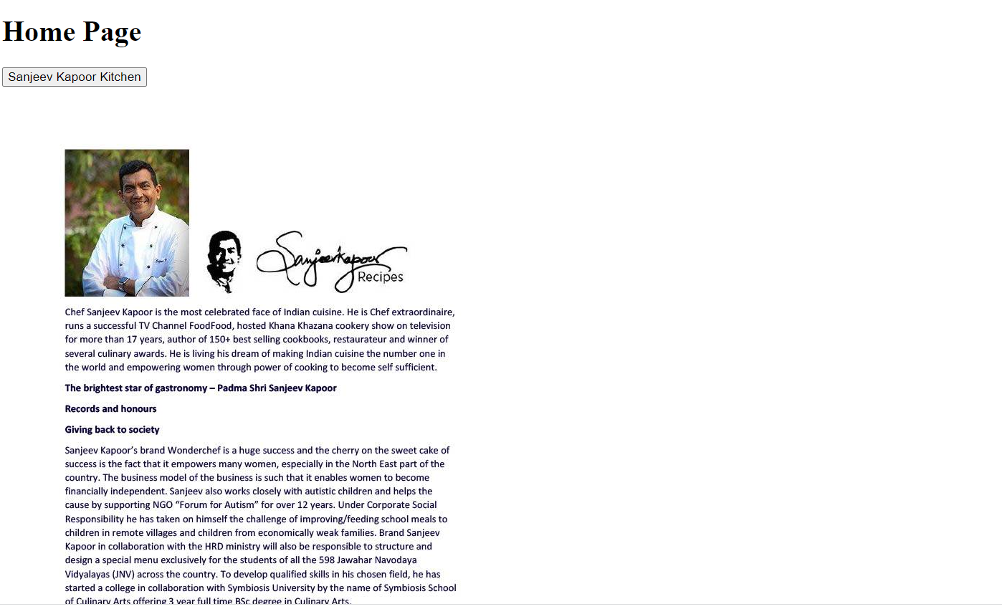
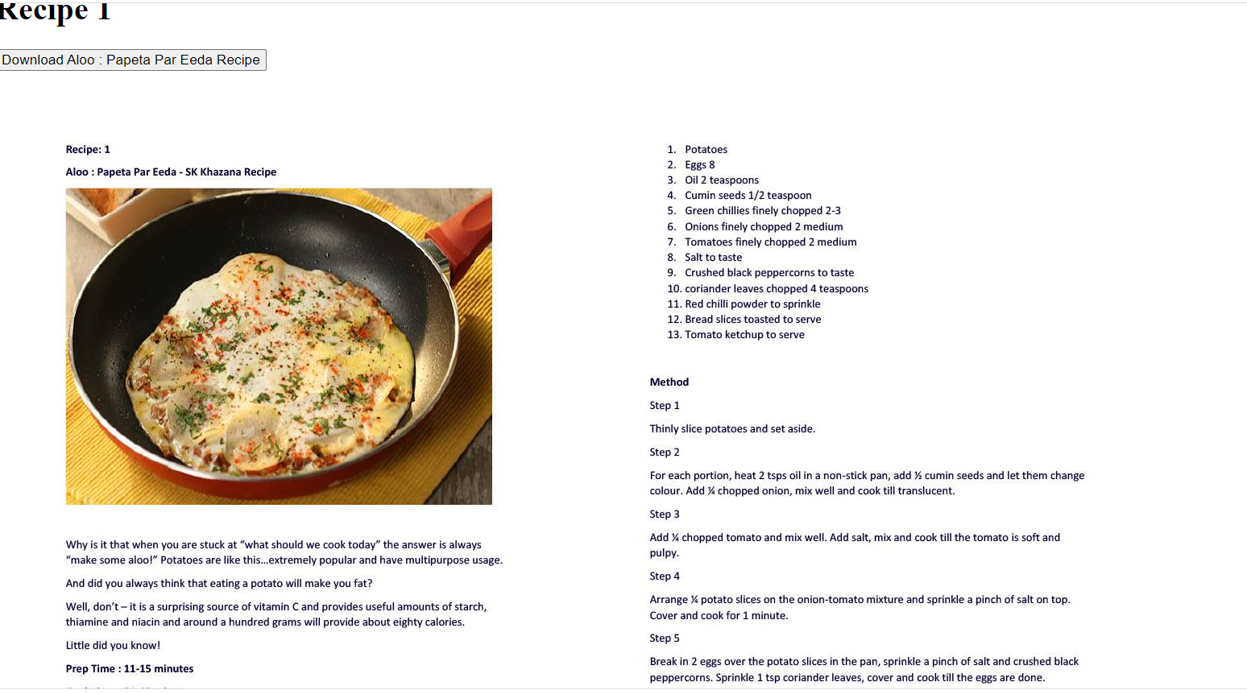
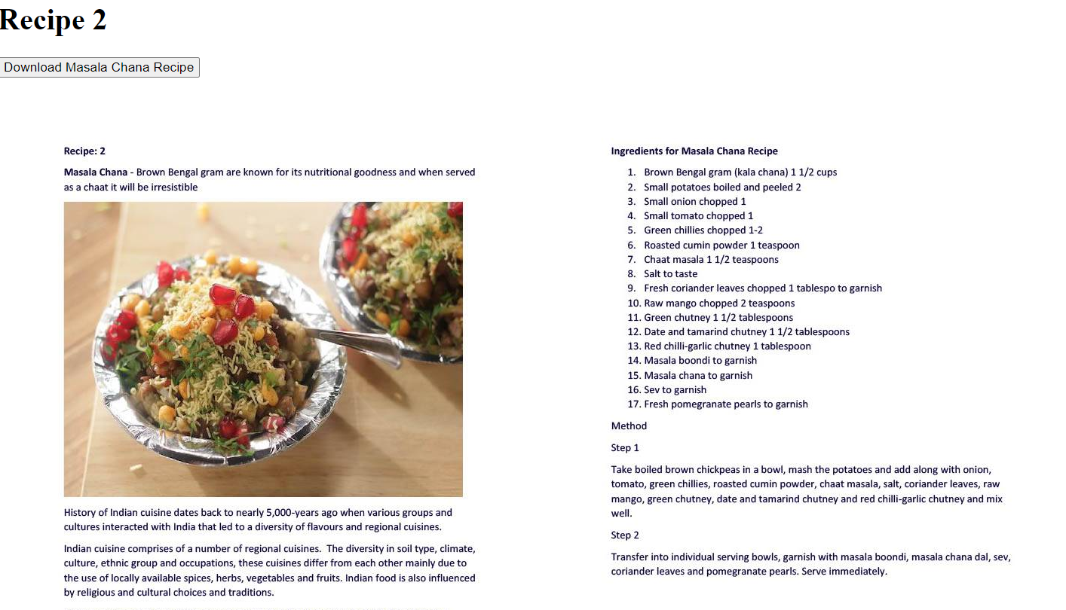
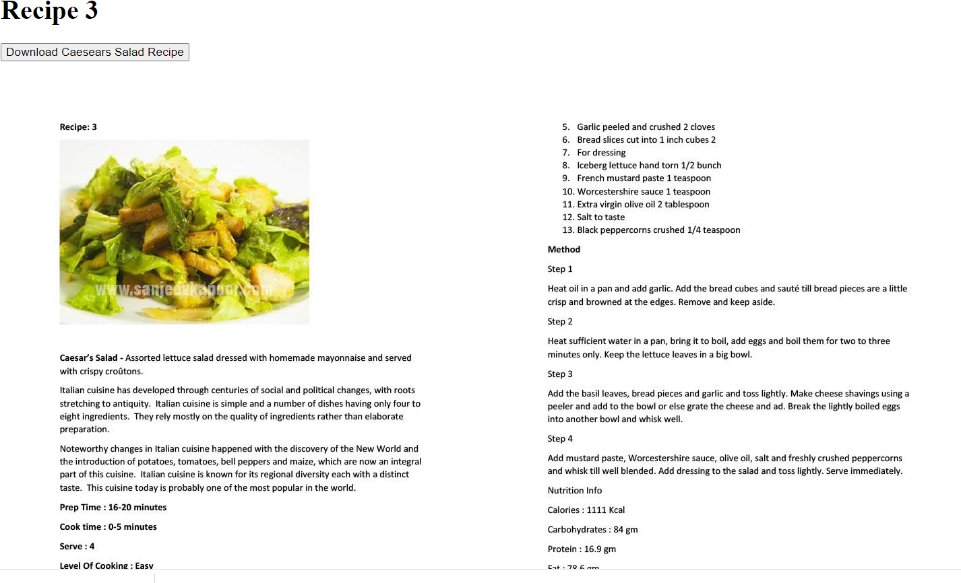
Create Web Application with Database
Project is to link up a Celebrity Chef with choice of 3 recipes for the user to select.

Slide 3
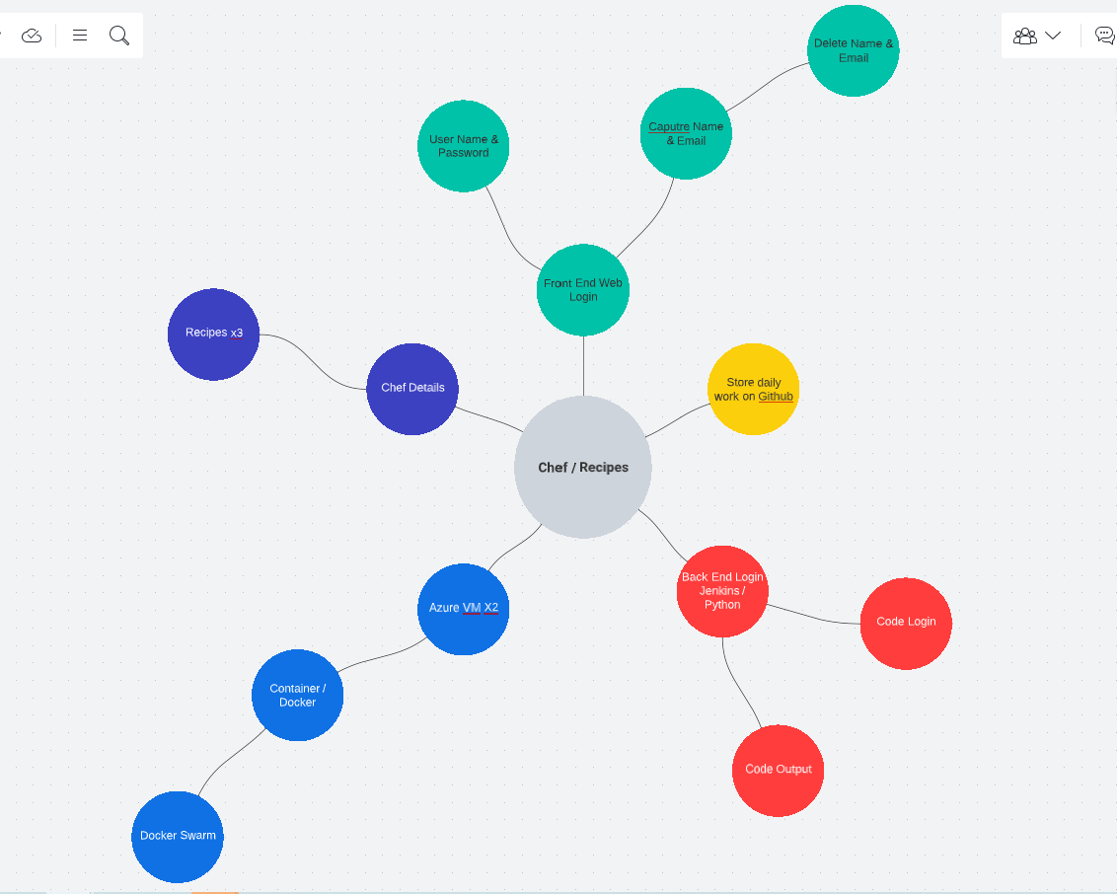
Mind Map

Slide 4
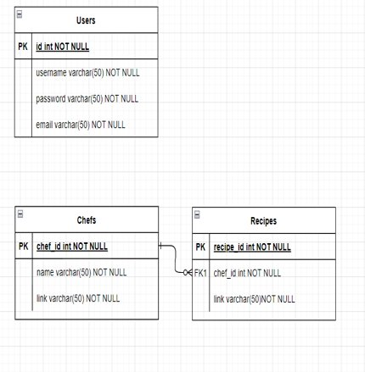
Database Table

Slide 5
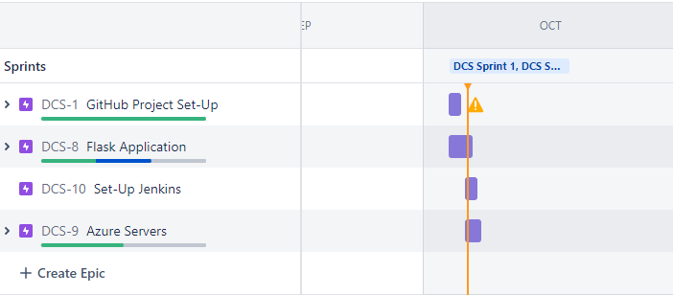
Jira Sprints

Slide 6
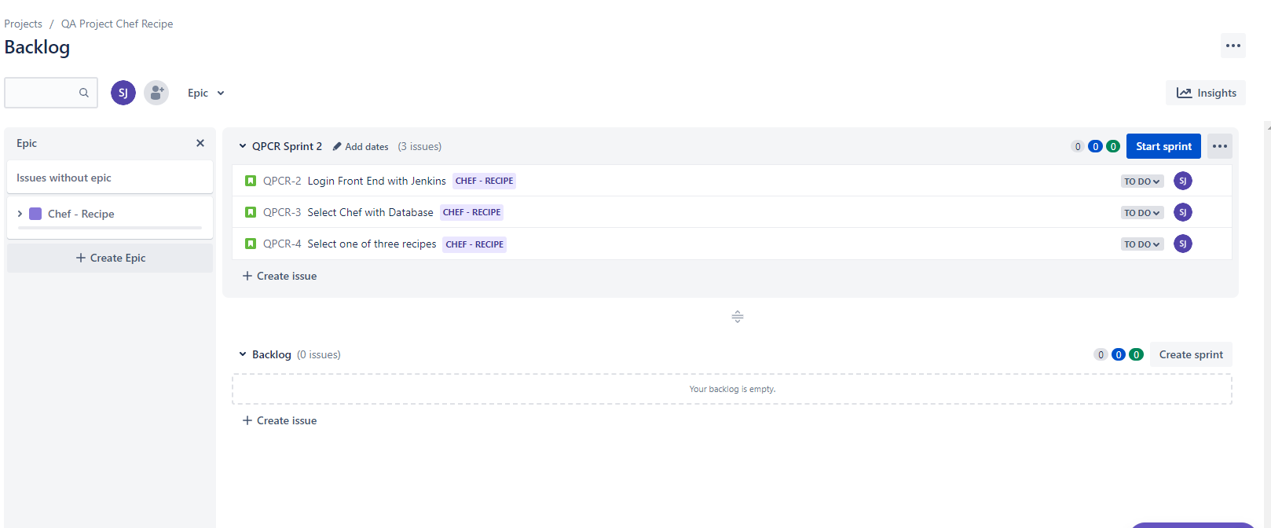
Jira

Slide 7
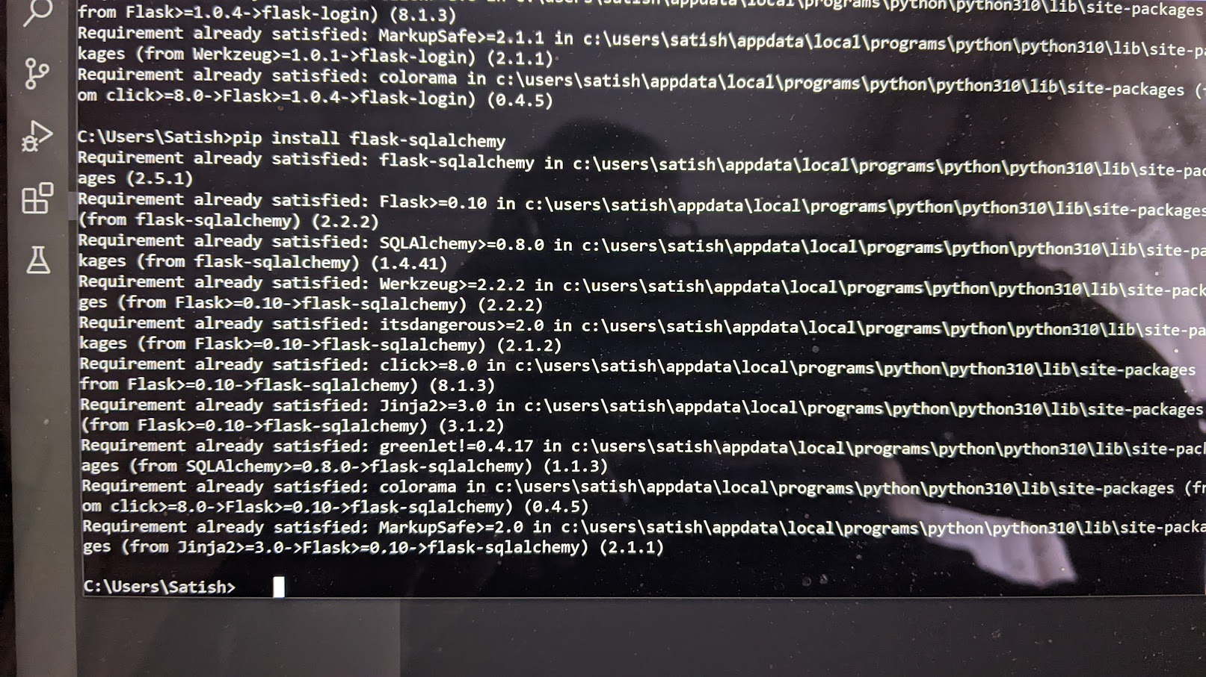
Add Flask

Slide 8
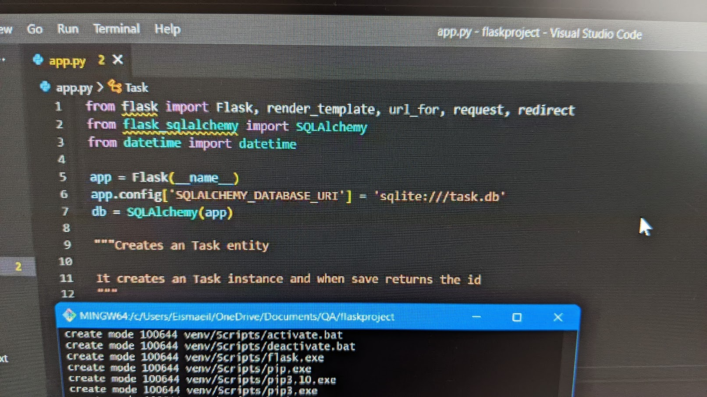
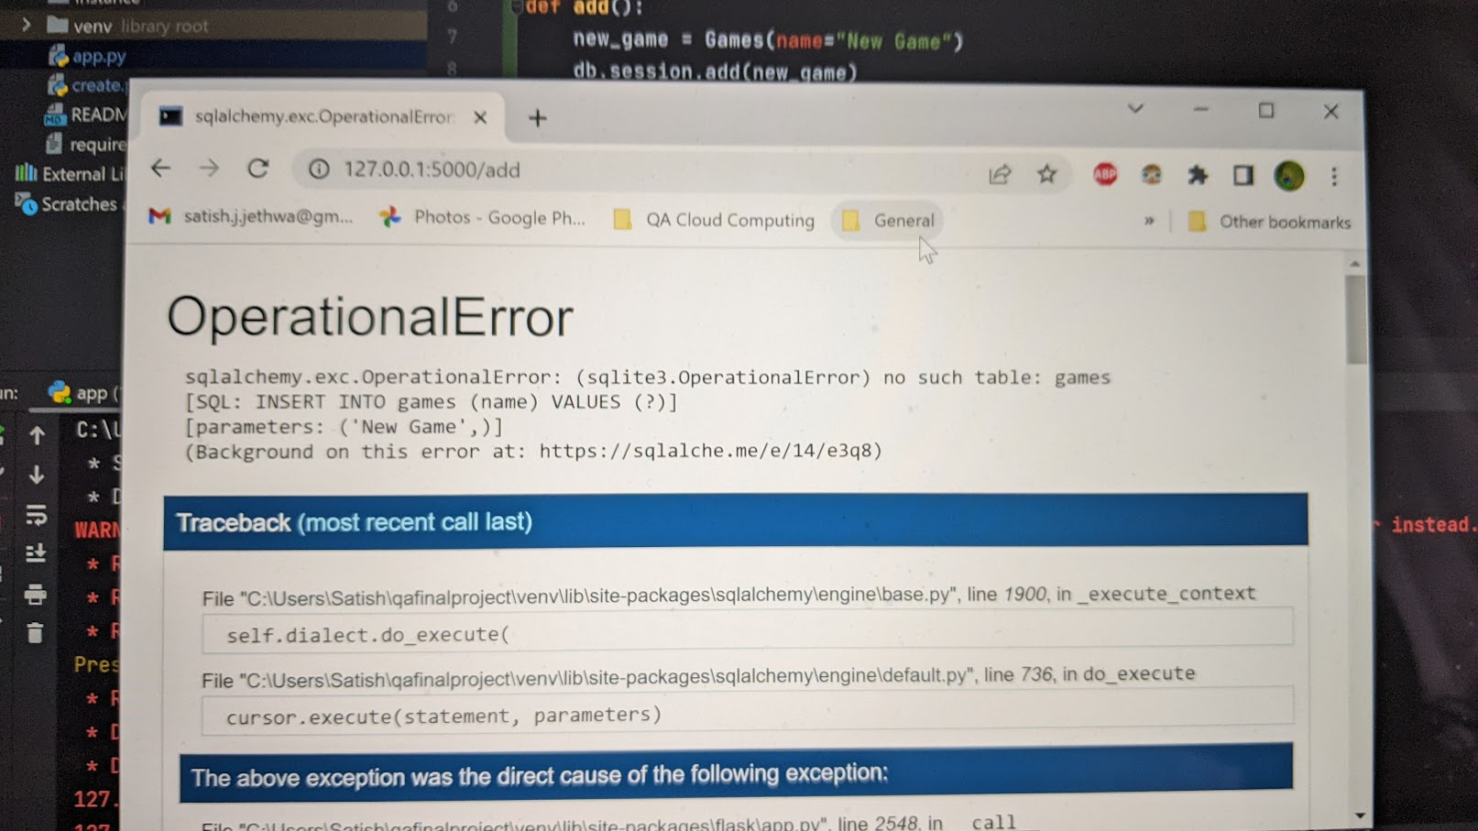
Sqlalchemey Error

Slide 9
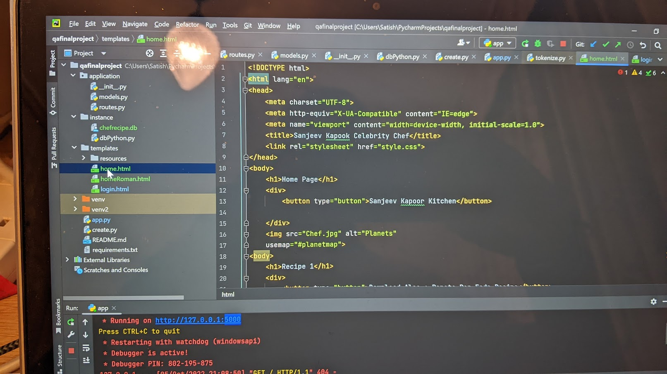
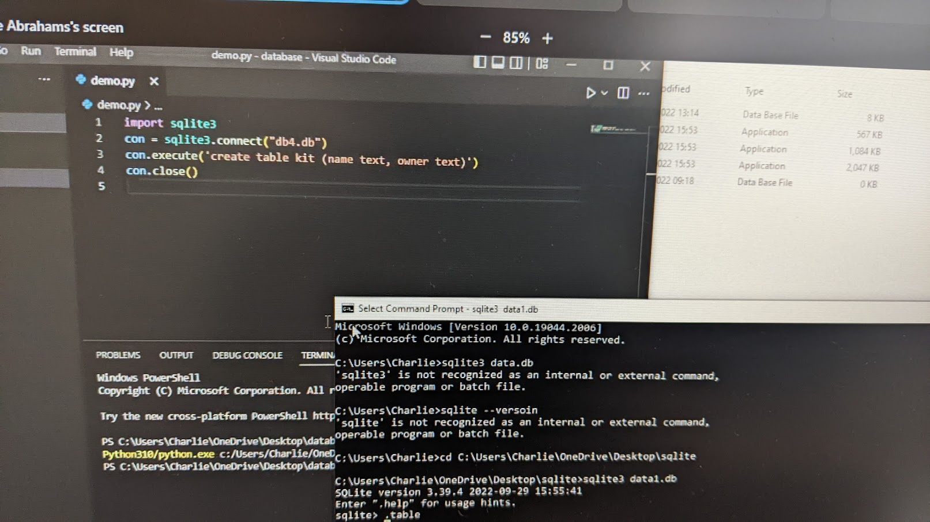
Loading Up PyCharm

Slide 10
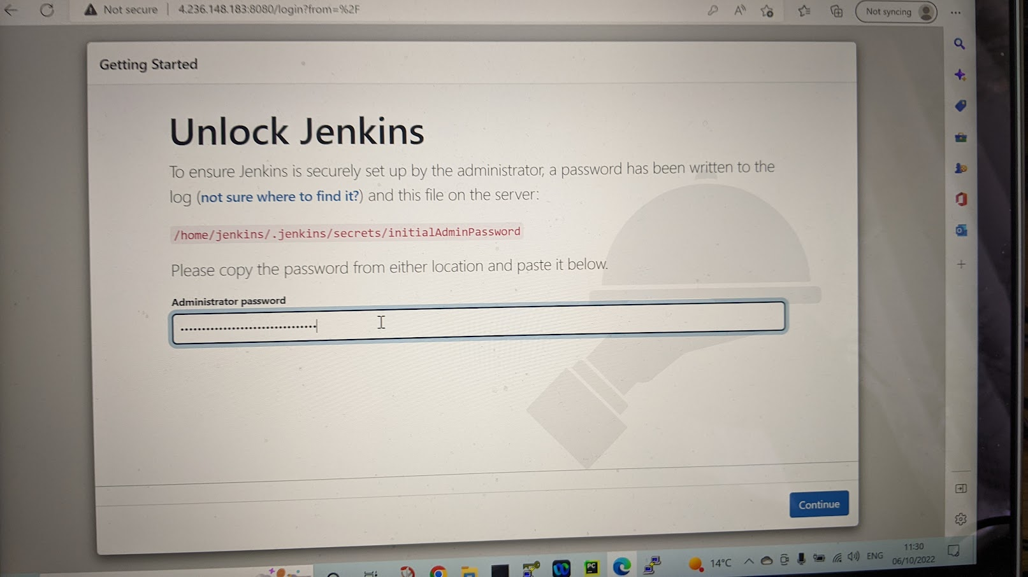
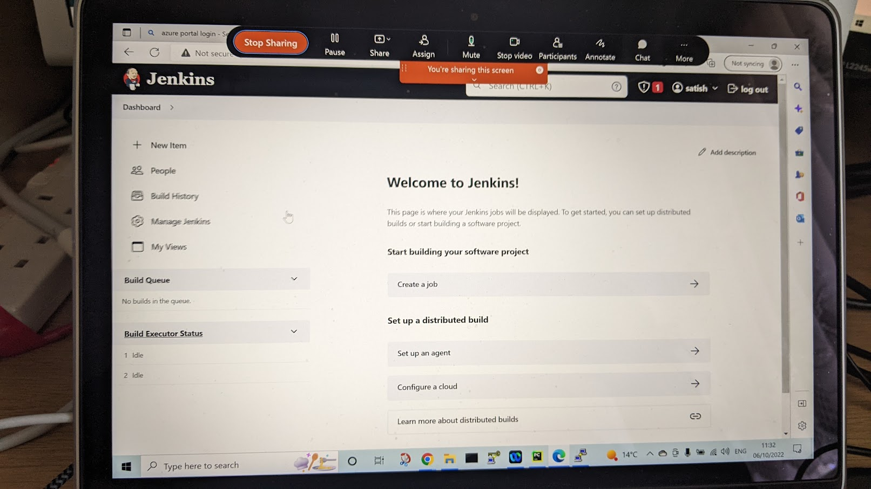
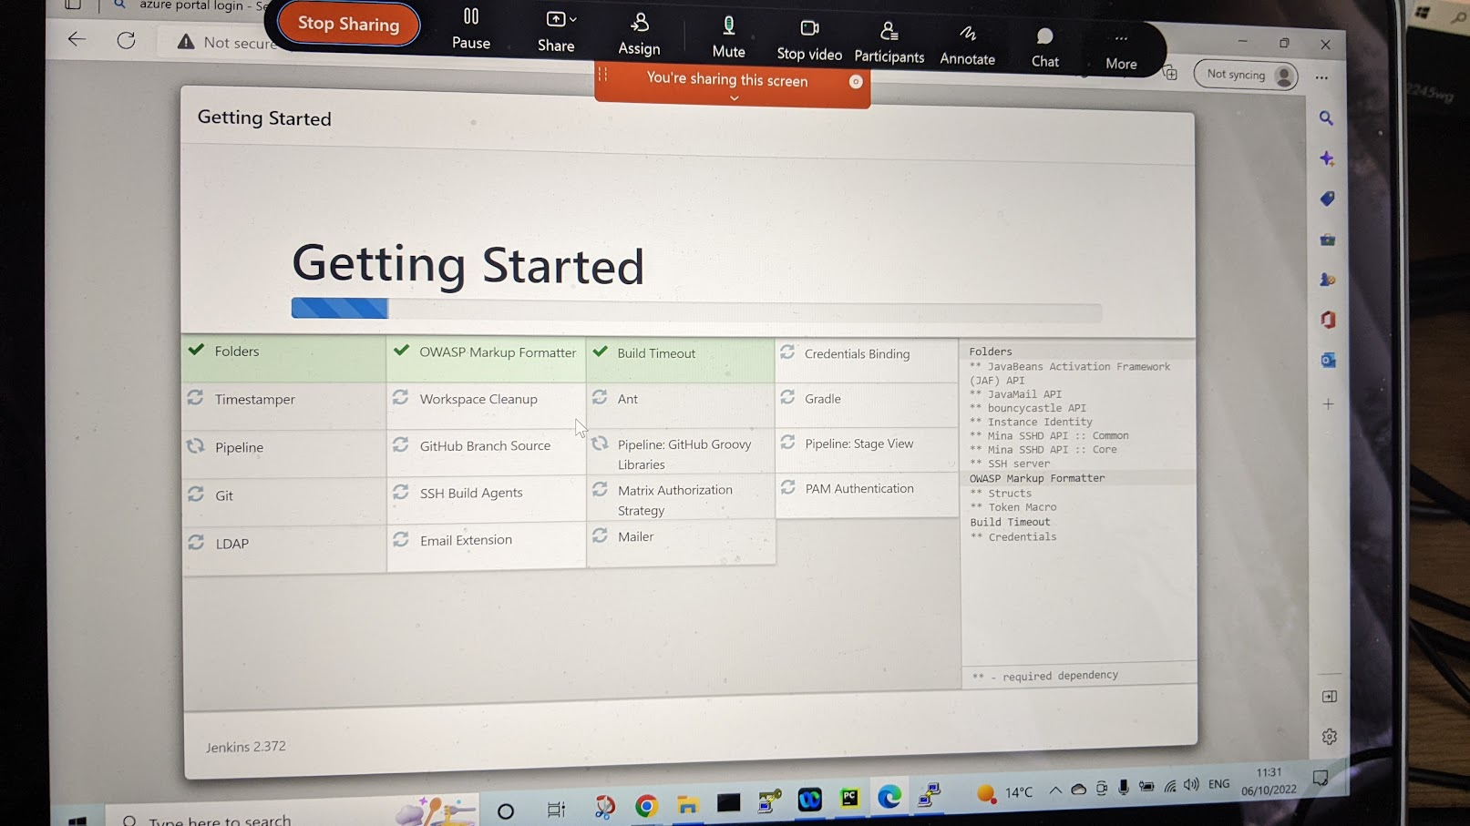
Setting Up Jenkins

Slide 11
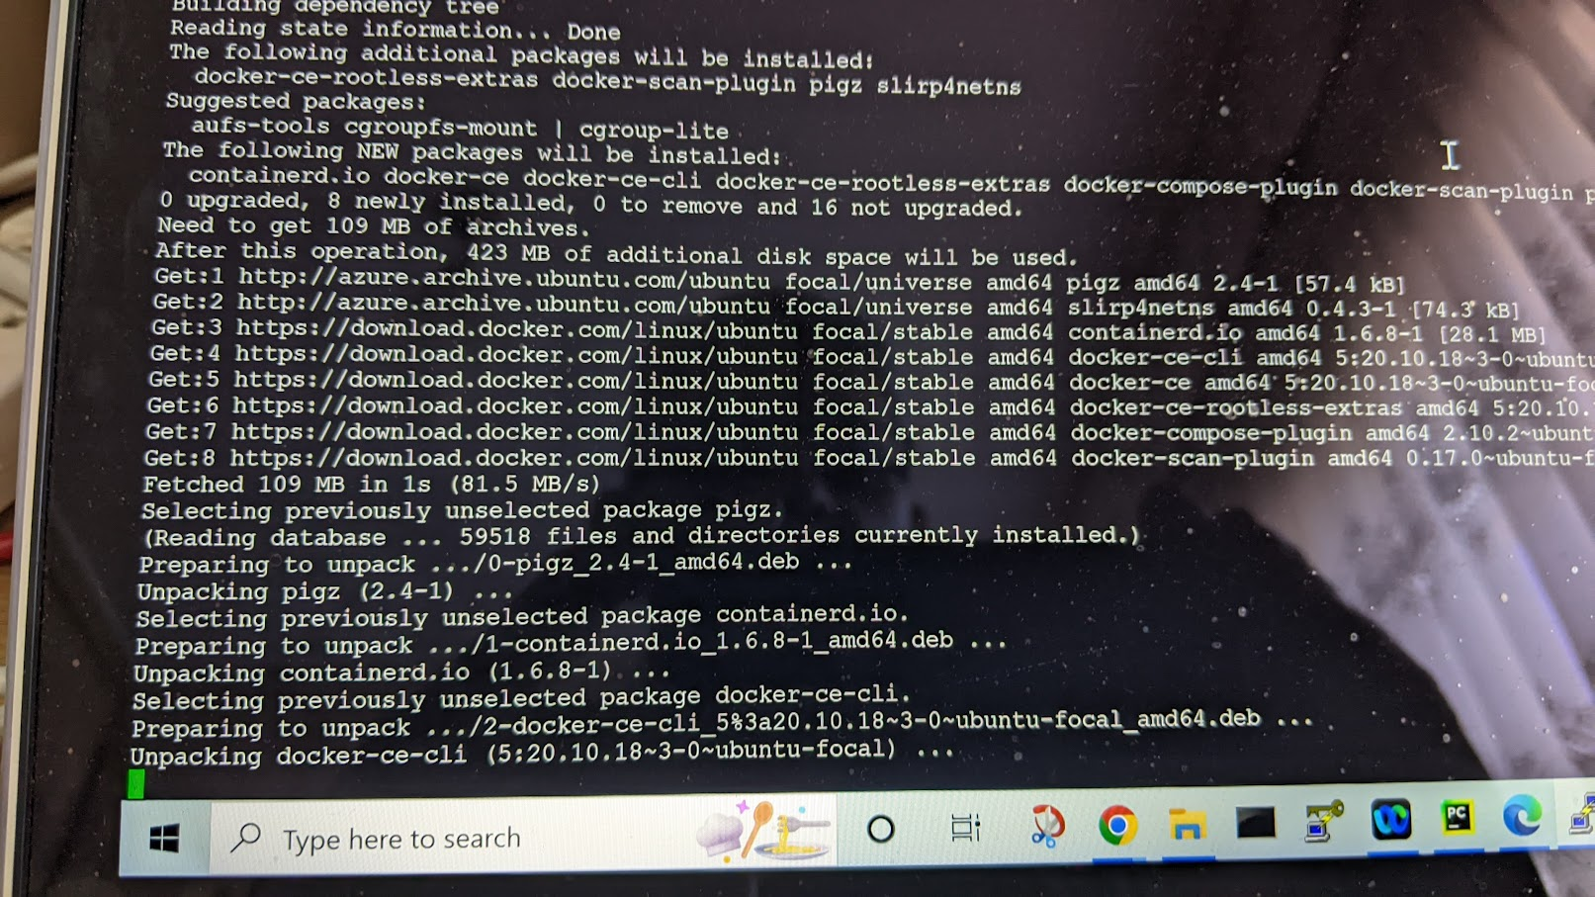
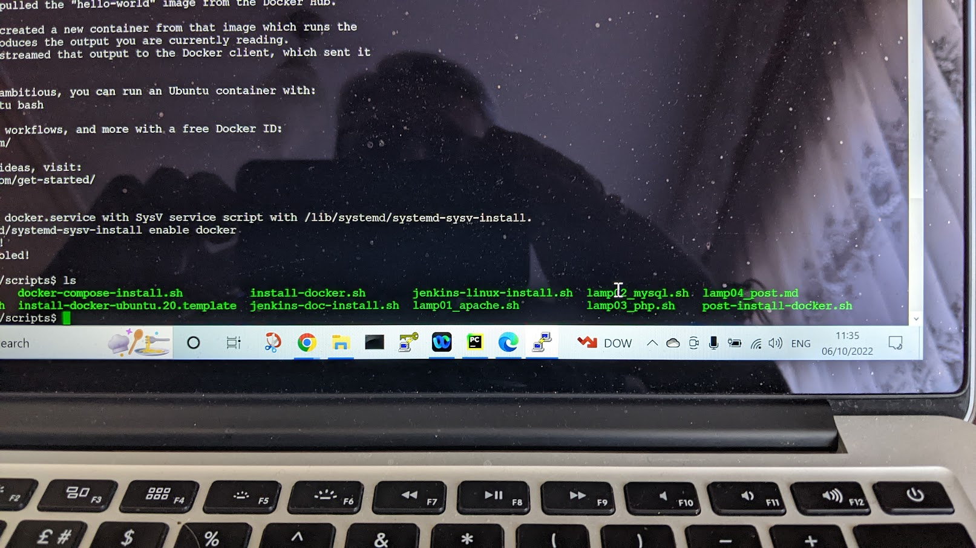
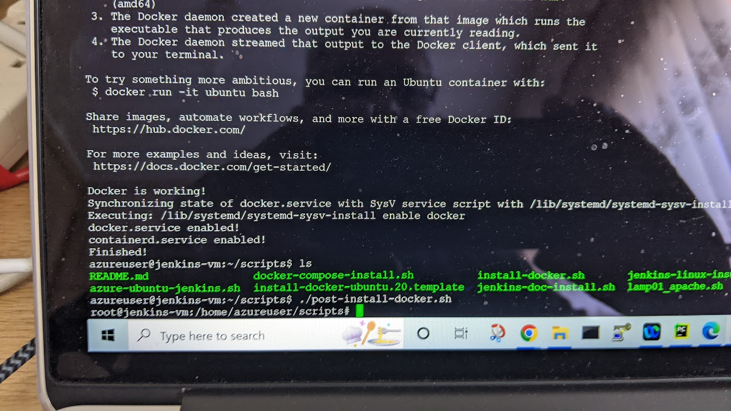
Back End Tasks: Docker / Container Build Up

Slide 12
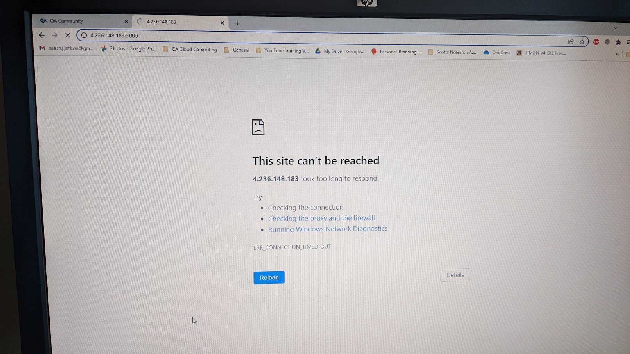
Errors : Images not showing up

Slide 13
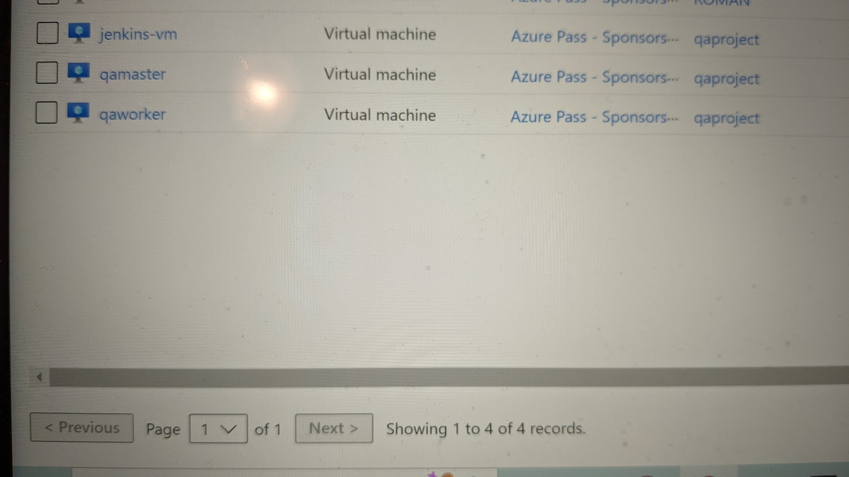
Install the 3 VM's

Slide 14
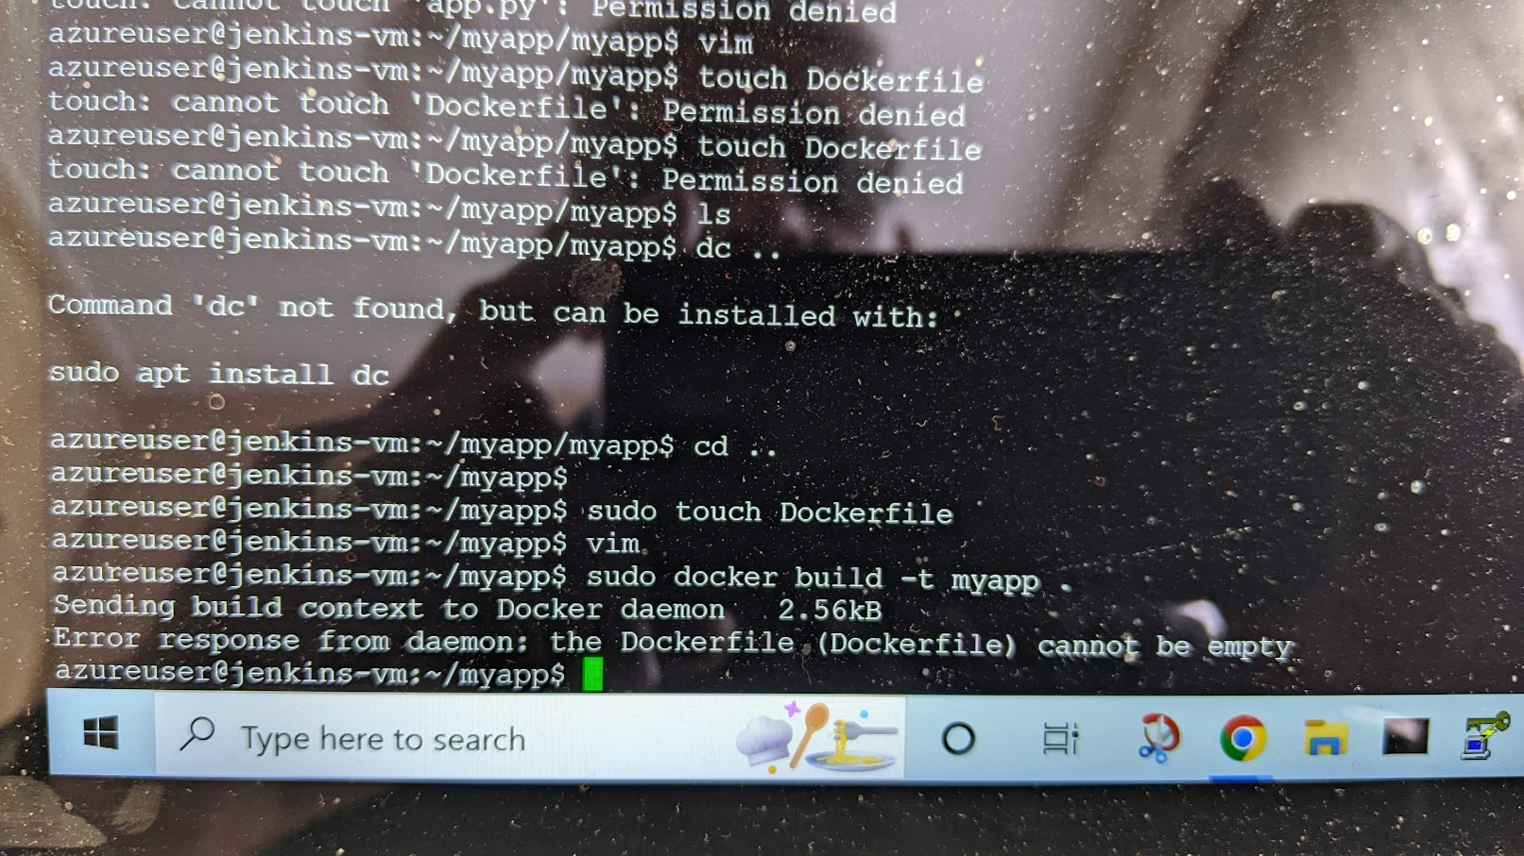
Error Tasks:

Slide 15
Build Tasks: Finally loaded up files

Slide 16
Deployment:

Slide 17
Deliverable:

Slide 18
Summary:
This project has been Great and Difficult as in one way it's made sure that I output what I have learnt over the 10 weeks.
Personally as a 58 year old I have been able to collate the intensive tutorials that have been First Class both on the QA Portal and with the QA Tutors who have been true Professionals.
I have found putting the project together demanding as mentally in my mind it sits correctly like a puzzle, however when the apps crash and error upon errors occur on the terminals it one step forward and 20 backwards.
Sadly I feel I have failed due to lack of time on finishing off my project and on GitHub and Azure hence got help from a fellow student that I collaborated with to learn everything from start to finish as I wanted to see the end result this being the front end to back end to the finished result.

